Slide 1
To replace with my own drawing

Slide 2
CSS143 Computer Programming (II)

Slide 3

Comparison
”My car is faster than yours!”

Slide 4
Comparison
”This algorithm is faster than that algorithm!”
”Array is faster than single linked list”

Slide 5

Complexity
Worst case scenario
Usage of resources
Number of Comparison
Memory allocation

Slide 6
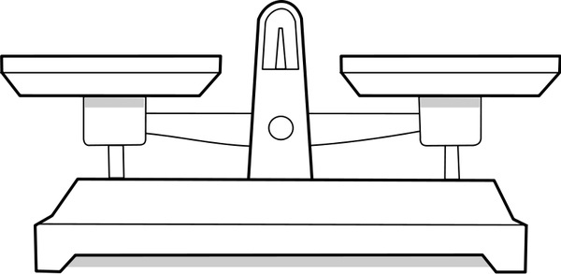
Weighting 9 boxes
9 boxes, same size, equally heavy - except for one, which is a little heavier.
With a pair of balance scales, how to identify the heavier ball?

Slide 7
Performance Puzzle

Slide 8
Complexity
Worst case scenario
Usage of resources
Number of Comparison
Memory allocation
Finding the answer till the last weighting
Least amount of weighting

Slide 9
Performance Puzzle

Slide 10
Performance Puzzle

Slide 11
Performance Puzzle

Slide 12
Performance Puzzle
Number of comparison (weighting): 3
Can we do better with less comparision?

Slide 13

Another example…
1 in 9 has COVID
Testing is expensive & slow

Slide 14
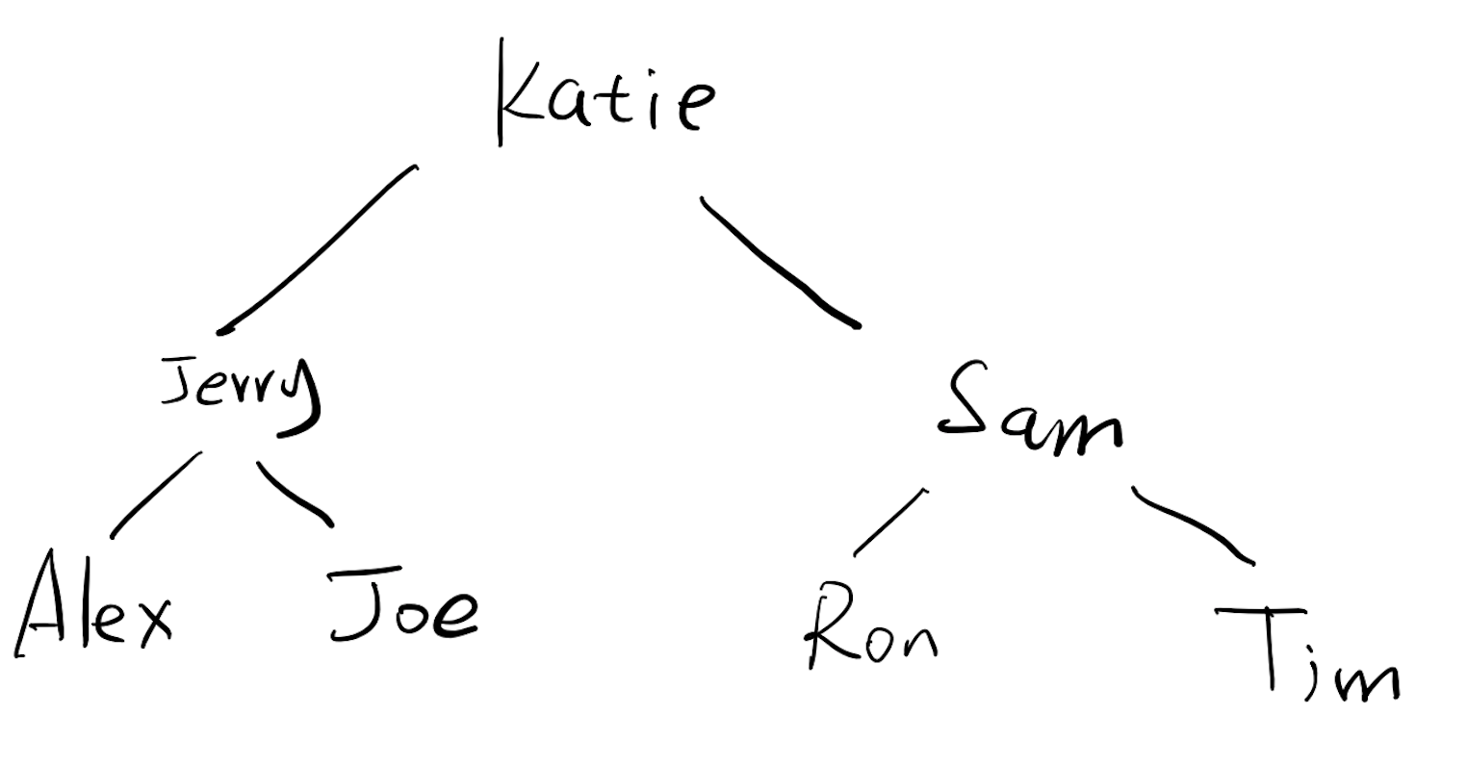
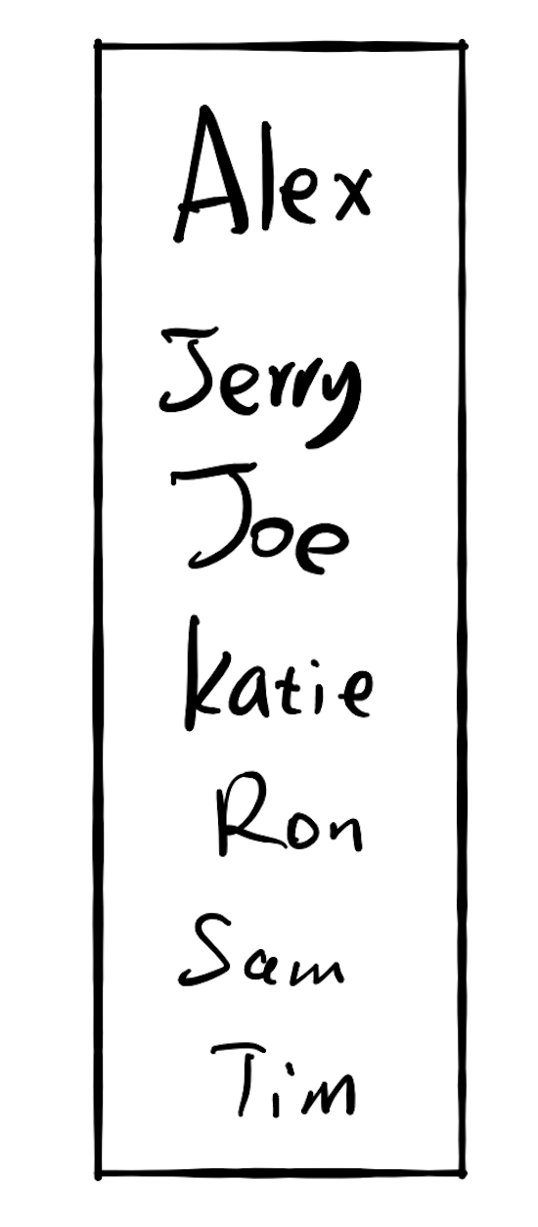
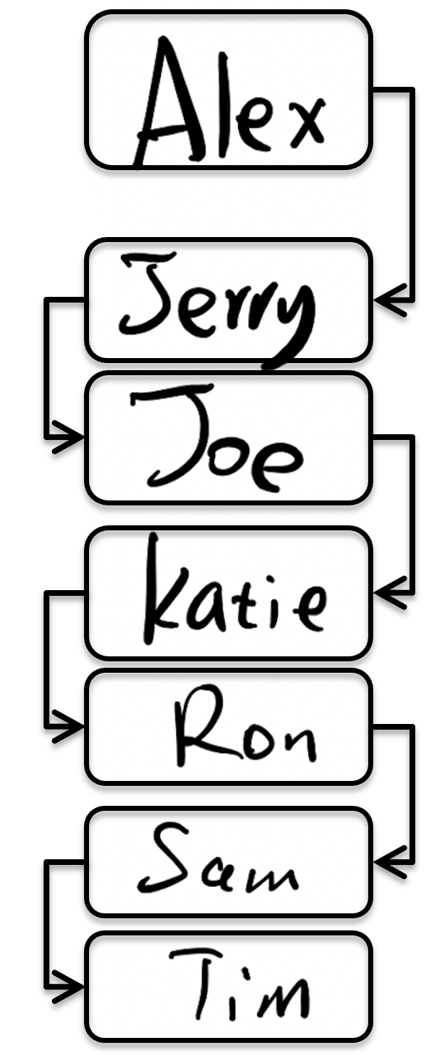
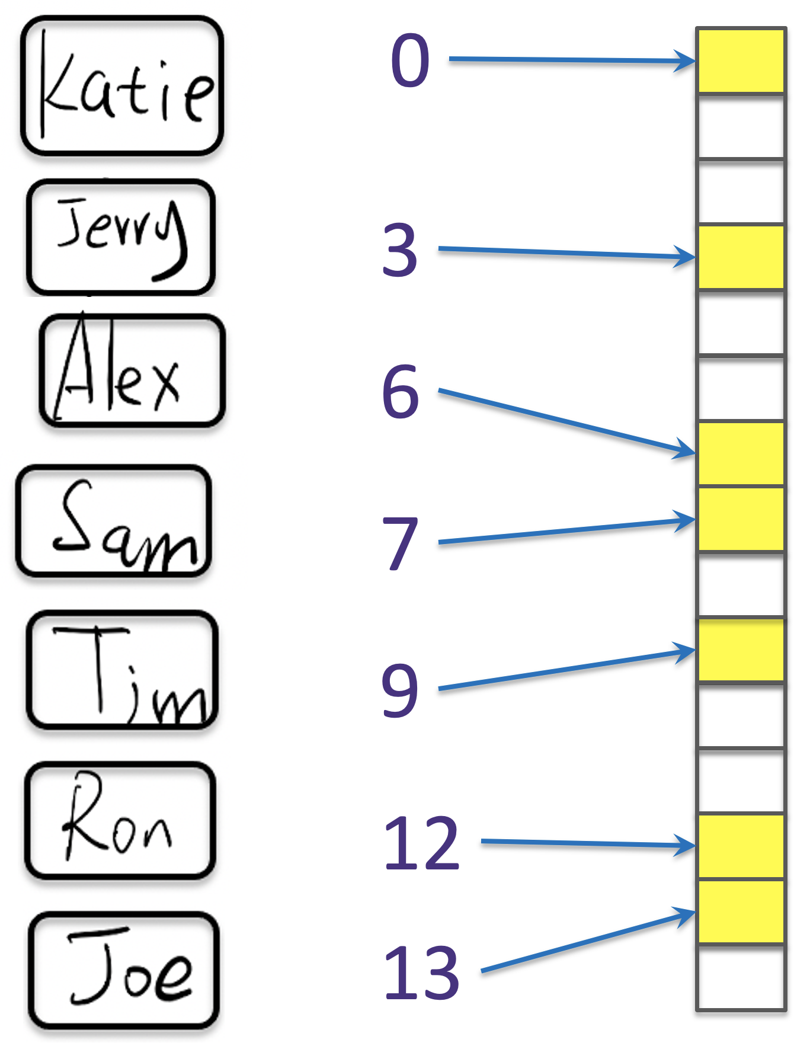
If there are 10,000 users
13s
Each comparison takes 1 seconds
13s
2.78m
~1s

Slide 15
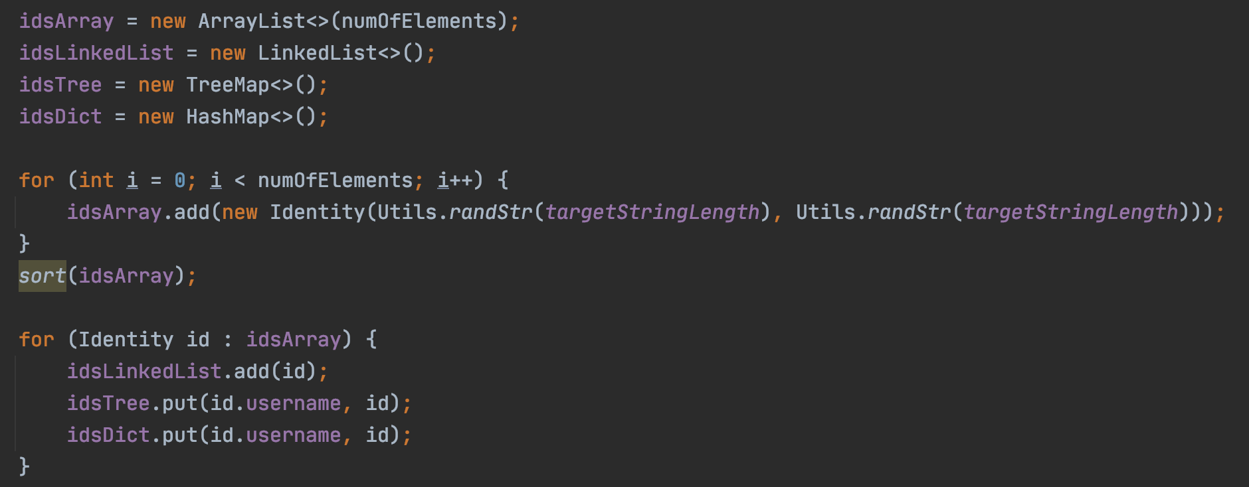
Perf Tests

Slide 16
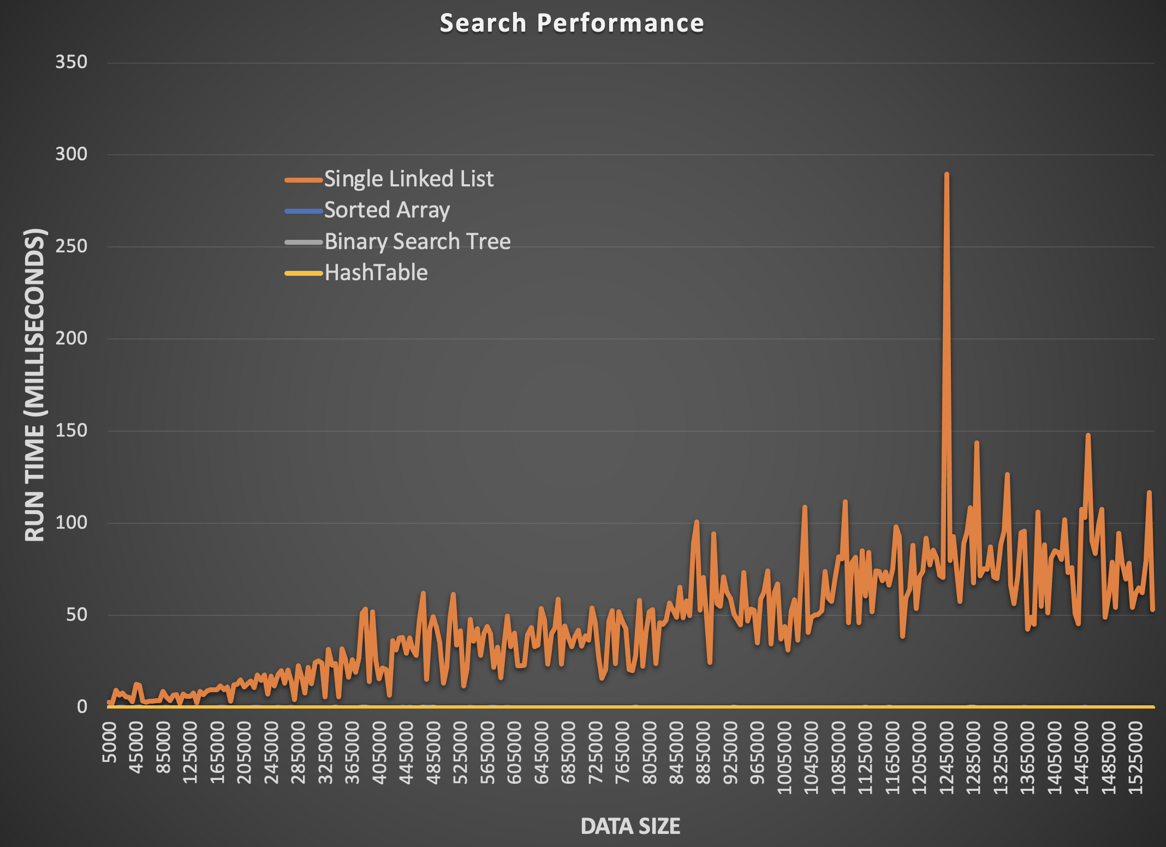

Slide 17
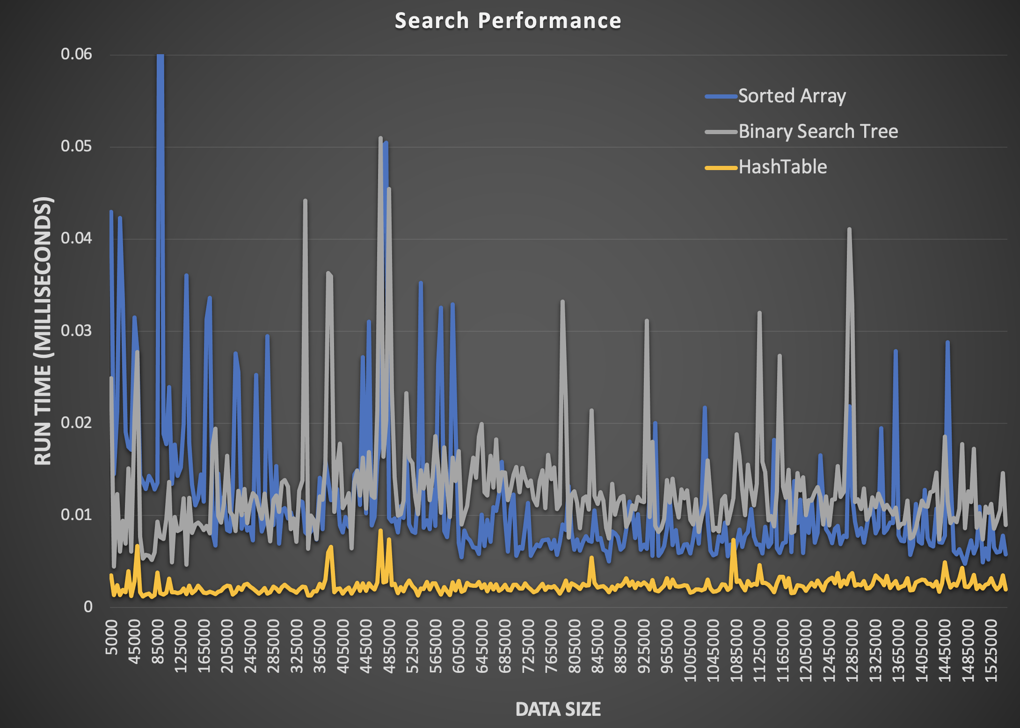

Slide 18
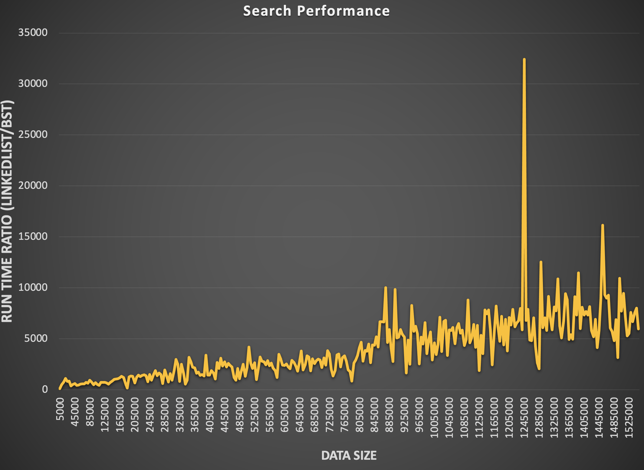

Slide 19
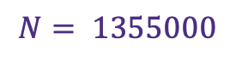
If there are10,000 users
0.009577 ms
Each comparison takes 1 seconds
0.017723
6.649668 ms
0.001607 ms
$$N= 1355000$$

Slide 20
Hashtable as a cache
Size limited
Extremely fast access

Slide 21
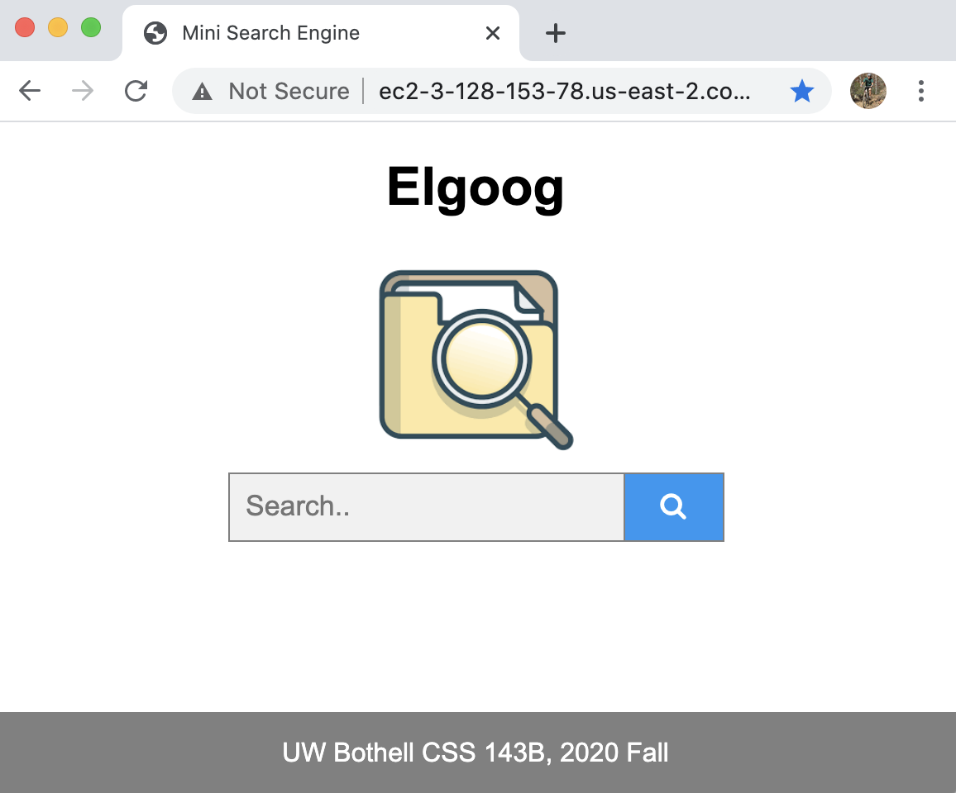
Final Project

Slide 22

Final Project Review
"/", "/search", "/home"
Controller
Repository
Database
Service
Webpage

Slide 23
Final Project Review
Cache
?
"/", "/search", "/home"
Controller
Repository
Database
Service
Webpage

Slide 24
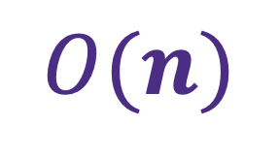
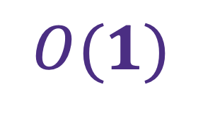
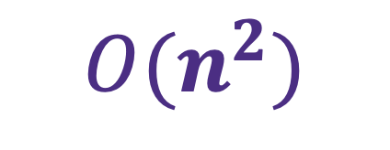
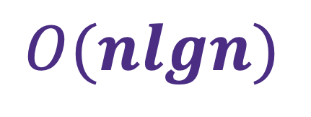
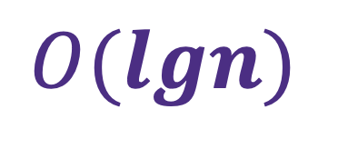
“Big O” notation
$$O(1)$$
Space
$$O(n)$$
Execution time
$$O(lgn)$$
Worst case scenario
$$O(nlgn)$$
$$O(n^{2})$$

Slide 25
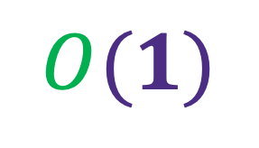
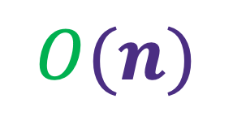
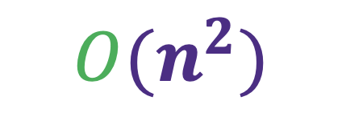
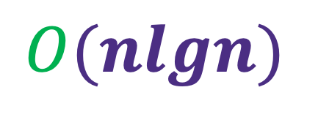
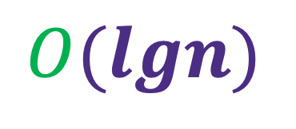
$$O(n)$$
$$O(1)$$
“O” read as “order of”
$$O(lgn)$$
$$O(nlgn)$$
$$O(n^{2})$$

Slide 26
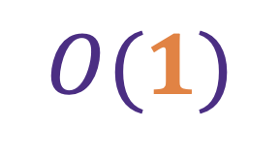
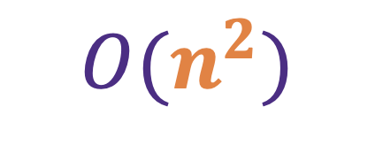
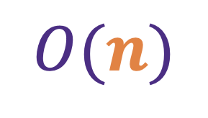

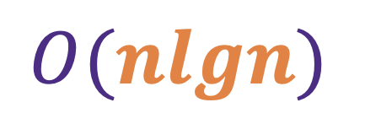

$$O(n)$$
Speed of increase as $n$ grows
$$O(1)$$
$$O(lgn)$$
$$O(nlgn)$$
$$O(n^{2})$$

Slide 27
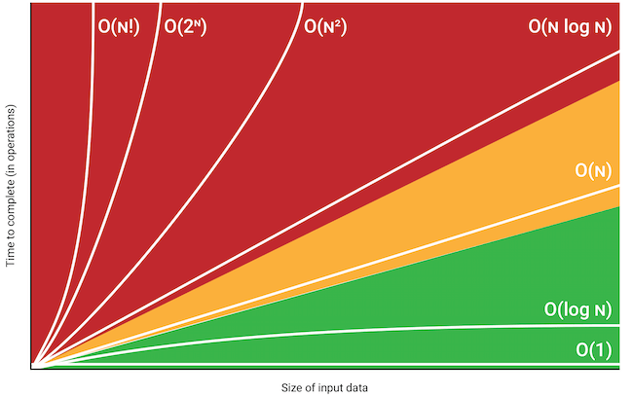
$$O(n)$$
Speed of increase as $n$ grows
$$O(1)$$
$$O(lgn)$$
$$O(nlgn)$$
$$O(n^{2})$$

Slide 28
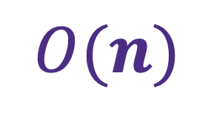
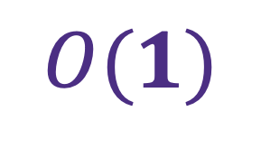
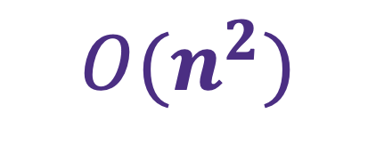
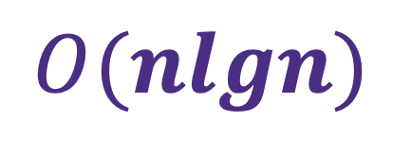
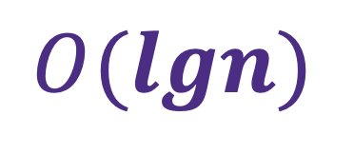
Search in
Space
$$O(1)$$
Execution time
$$O(n)$$
$$O(lgn)$$
$$O(nlgn)$$
$$O(n^{2})$$

Slide 29
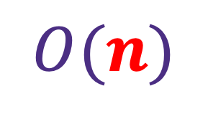


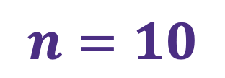
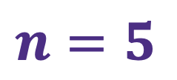
Search in
Space
$$O(1)$$
Execution time
$$O(n)$$
$$n=5$$
$$n=10$$
$$n=10,000$$

Slide 30

Complexity in Sorting Algorithms
Bubble Sort
Insertion Sort

Slide 31
The Bubble Sort Story
http://computationaltales.blogspot.com/2011/04/bullies-bubble-sort-and-soccer-tickets.html

Slide 32
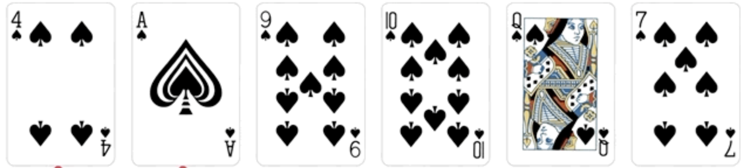
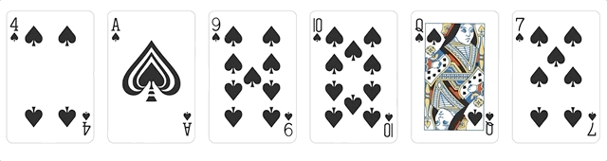
Sort the cards!
https://marvinpdroid.medium.com/sort-like-a-boss-80ee71fc88e5

Slide 33
Sorting Algorithm
Given a set of random number, how to sort it?
Descending Order
1
3
How many comparison?

Slide 34
Sorting Algorithm
Given a set of random number, how to sort it?
Descending Order
1
3
5
1

Slide 35
Sorting Algorithm
Given a set of random number, how to sort it?
Descending Order
3
5
1
How many comparison?

Slide 36
Sorting Algorithm
Given a set of random number, how to sort it?
Descending Order
1
5
7
8
5
7
8
1
7
8
5
1
8
7
5
1
How many comparison?

Slide 37
Sorting Algorithm
Given a set of random number, how to sort it?
Descending Order
x₁
x₂
x₃
……
x_{n}
How many comparison?

Slide 38
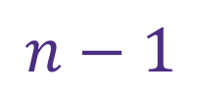


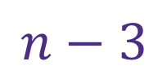
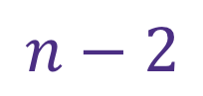
Sorting Algorithm
Given a set of random number, how to sort it?
x₁
x₂
x₃
……
x$N$
$$n−1$$
1st round:
$$n−2$$
2nd round:
$$n−3$$
3rd round:
……
……
N^{th} round:
$$1$$

Slide 39
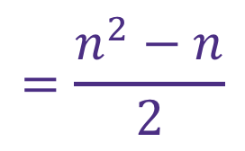
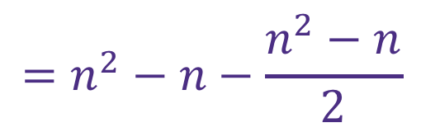
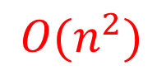
Sorting Algorithm
Given a set of random number, how to sort it?
x₁
x₂
x₃
……
x$N$
$$\left(n−1\right)+\left(n−2\right)+\left(n−3\right)+…+2+1$$
$$\left(n−1\right)+\left(n−2\right)+\left(n−3\right)+…+2+1$$
$$\left(n−1\right)+\left(n−2\right)+…+(n−\left(n−2\right))+(n−\left(n−1\right))$$
$$=\left(n−1\right)×n−(1+2+3+…+\left(n−1\right))$$
$$=n^{2}−n−\frac{n^{2}−n}{2}$$
$$=\frac{n^{2}−n}{2}$$
$$O(n^{2})$$

Slide 40
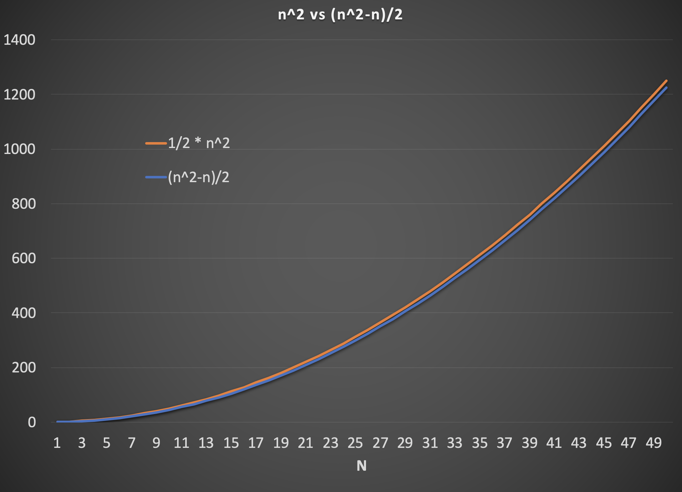
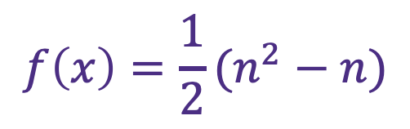
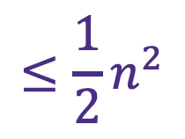
$$f\left(x\right)=\frac{1}{2}(n^{2}−n)$$
$$≤\frac{1}{2}n^{2}$$

Slide 41
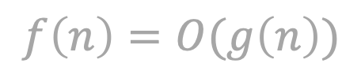
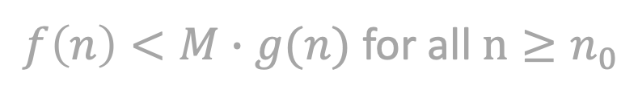
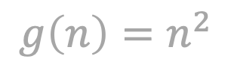
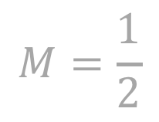
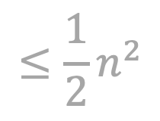


Big O
$$f\left(n\right)=O(g\left(n\right))$$
If and only if there exists a positive number $M$ exists such that:
$f\left(n\right)<M∙g(n)$ for all $n≥n_{0}$
$$M=\frac{1}{2}$$
$$f\left(n\right)=\frac{1}{2}(n^{2}−n)$$
$$≤\frac{1}{2}n^{2}$$
$$g\left(n\right)=n^{2}$$
$$f\left(n\right)=O(n^{2})$$

Slide 42


Bubble Sort Complexity
$$O(n^{2})$$

Slide 43
Complexity in Sorting Algorithms
Bubble Sort
Insertion Sort

Slide 44

Sort the cards!
https://marvinpdroid.medium.com/sort-like-a-boss-80ee71fc88e5

Slide 45
Insertion Sort
Insert number one by one to their proper location
1
8
6
3
2
7

Slide 46
Insertion Sort
Insert number one by one to their proper location
1
6
8
3
2
7

Slide 47
Insertion Sort
Insert number one by one to their proper location
1
3
6
8
2
7

Slide 48
Insertion Sort
Insert number one by one to their proper location
1
2
3
6
8
7

Slide 49
Insertion Sort
Insert number one by one to their proper location
1
2
3
6
7
8

Slide 50



Insertion Sort complexity
Descending Order
1
2
3
4
6
7
$$1$$
2
1
3
4
6
7
$$2$$
2
1
3
4
6
7
$$3$$
……
……

Slide 51

Insertion Sort complexity
Descending Order
1
2
3
4
6
7
$$1$$
2
1
3
4
6
7
$$2$$
2
1
3
4
6
7
$$3$$
$$1+2+3+…+\left(n−1\right)=\frac{n^{2}−n}{2}$$

Slide 52
Insertion Sort

Slide 53
Insertion Sort
http://computationaltales.blogspot.com/2011/04/why-tailors-use-insertion-sort.html

Slide 54




Insertion Sort
Array
LinkedList
Comparison $O(n^{2})$
Data shuffle $O(n^{2})$
Comparison $O(n^{2})$
Data shuffle $O(1)$

Slide 55
Performance Puzzle

Slide 56
Performance Puzzle

Slide 57
Final Project

Slide 58
Doc 0 : "hello world", Doc 1 : "hello", Doc 2 : "world", Doc 3 : "world world hello", Doc 4 : "seattle rains hello abc world", Doc 5: "sunday hello world fun"
Search “hello world”

Slide 59
Homework 6 Review
Doc 0 : "hello world", Doc 1 : "hello", Doc 2 : "world", Doc 3 : "world world hello", Doc 4 : "seattle rains hello abc world", Doc 5: "sunday hello world fun"
Search “hello world”
Returns [0, 3]

Slide 60
Doc 0 : "hello world", Doc 1 : "hello", Doc 2 : "world", Doc 3 : "world world hello", Doc 4 : "seattle rains hello abc world", Doc 5: "sunday hello world fun"
Search “hello”
Returns [0, 1, 3, 4, 5]

Slide 61
Doc 0 : "hello world", Doc 1 : "hello", Doc 2 : "world", Doc 3 : "world world hello", Doc 4 : "seattle rains hello abc world", Doc 5: "sunday hello world fun"
Search “seattle ra”
Returns []

Slide 62
Doc 0 : "hello world", Doc 1 : "hello", Doc 2 : "world", Doc 3 : "world world hello", Doc 4 : "seattle rains hello abc world", Doc 5: "sunday hello world fun"
Search “sunday fun”
Returns []

Slide 63

Indexing
Indexer
Searcher
Index
Search
Search

Slide 64
Indexing
Doc 0 : "hello world", Doc 1 : "hello", Doc 2 : "world", Doc 3 : "world world hello", Doc 4 : "seattle rains hello abc world", Doc 5: "sunday hello world fun"
Search “hello world”
Indexing:
word → document + location
hello → document{0, location{0}}
document{1, location{0}}
document{3, location{2}}
document{4, location{2}}
document{5, location{1}}

Slide 65
Indexing
Doc 0 : "hello world", Doc 1 : "hello", Doc 2 : "world", Doc 3 : "world world hello", Doc 4 : "seattle rains hello abc world", Doc 5: "sunday hello world fun"
Search “hello world”
Which document contains both words
Information required for search:
Location of each word in each document

Slide 66
Indexing
Doc 0 : "hello world", Doc 1 : "hello", Doc 2 : "world", Doc 3 : "world world hello", Doc 4 : "seattle rains hello abc world", Doc 5: "sunday hello world fun"
Search “hello world”
Which document contains both words
Information required for search:
Word → documents
Location of each word in each document
Word → locations in each document

Slide 67
Indexing
Doc 0 : "hello world", Doc 1 : "hello", Doc 2 : "world", Doc 3 : "world world hello", Doc 4 : "seattle rains hello abc world", Doc 5: "sunday hello world fun"
Search “hello world”
Which document contains both words
Information required for search:
“world” → documents[0,2,3,4,5]
Location of each word in each document
“world” → doc 0 {position 1}
doc 1 {}
doc 2 {position0}
doc 3 {position 0 & 1}
doc 4 {position 4}
doc 5 {position 2}

Slide 68
Indexing
Which document contains both words
Information required for search:
“world” → documents[0,2,3,4,5]
Location of each word in each document
“world” → doc 0 {position 1}
doc 1 {}
doc 2 {position0}
doc 3 {position 0 & 1}
doc 4 {position 4}
doc 5 {position 2}

Slide 69




Indexing
Indexing:
word → document + location

Slide 70
Indexing
Loop through each document
Split each document (a String) by white spaces
Add the location of each word into the index map

